Slide 1
HR Analytics Hackathon
Raja Rajeshwari S

Slide 2
2. Problem Statement
CHALLENGE :
Inefficient process for predicting eligible employees for promotion leads to delays.
GOAL:
Develop a predictive model to identify potential candidates and streamline promotions.
The hackathon goal is to predict employee promotions based on historical data. This involves analyzing patterns and trends to build a reliable predictive model.

Slide 3
3.Datasets Used
Training set (train_LZdllcl.csv)
Test set (test_2umaH9m.csv)
Key Variables:
Target: is_promoted
Features: Employee demographics, performance, and training scores.
Insights from Data Exploration:
Trends in promotions (e.g., impact of training scores or KPI completion)

Slide 4
Modeling Approach
Steps Performed:
Data preprocessing (handling missing values, outliers, encoding categorical variables).
Exploratory Data Analysis (EDA) to uncover insights and relationships.
Feature selection and engineering.
Model training and evaluation using machine learning algorithms.
Deployment using FastAPI

Slide 5
5. Model Development
Modeling:
Classification task with is_promoted as the target.
Focused on achieving high F1 score to balance precision and recall.
Performance: Present metrics such as accuracy, F1 score, precision, and recall.
Model Training: Logistic Regression with preprocessing.
Evaluation: Metrics and hyperparameter tuning to optimize performance

Slide 6
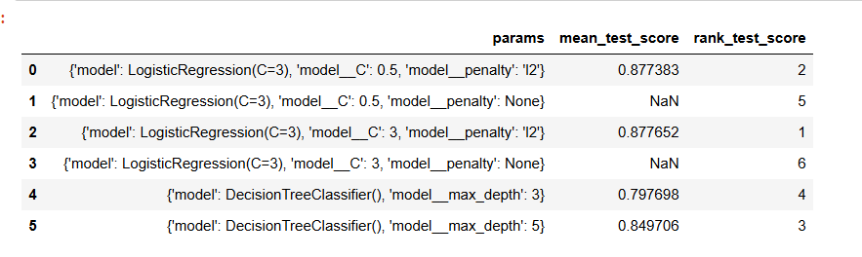
Final step of my predictive score

Slide 7
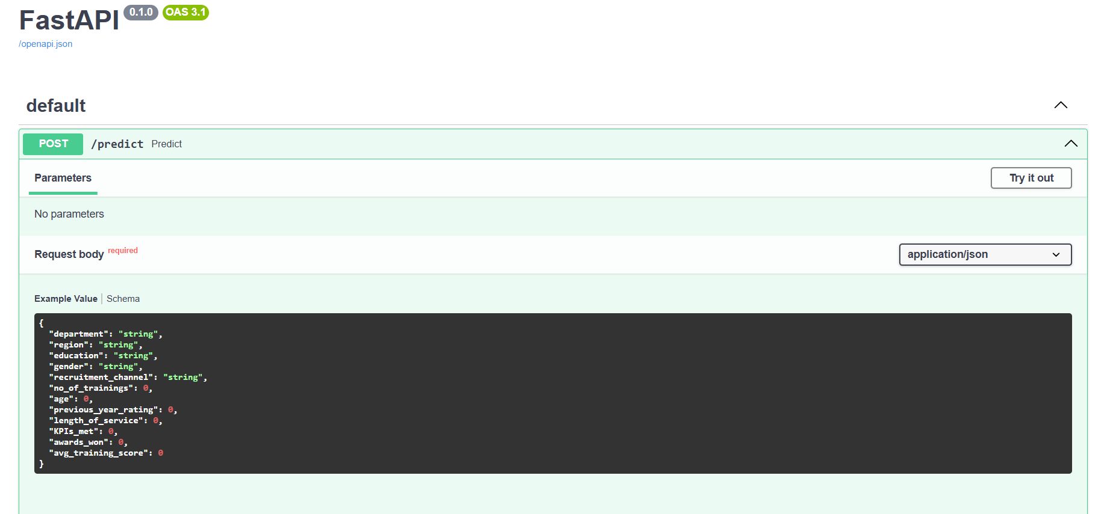
Using FastAPI

